Slide 1
Matlab 2 Python 2 FloPy3
Hamish Robertson

Slide 2
Course Staff
Fiona (Lead)
Hamish (Lead)
Tan
Laura
Khalil

Slide 3
Have you?
Installed Anaconda 3.5 ?
Installed Git ?
Made a GitHub account ?
Written down this number I’m about to give you

Slide 4
What we have done in the past…
USGS (United States Geological Survey) developed the ‘engines’ over many years; MODFLOW-2005, MODPATH etc…
They take input text files => Run => Output text files – Most common way programs ‘work’
Visual Modflow Flex makes it ‘easy’ for the user by creating and reading those files for you.
Software that cost £1000’s years ago
GUI- Graphical user interface e.g. Word, Excel etc…
Problems
Lack of support (costly)
Lack of updates and management by central Uni
You cant take a copy home with you!
Notoriously non-user friendly -> At the end of the course you probably never wanted to touch another hydrological model
Modflow Engines;
MODPATH
SEAWAT
GUI
Plotting Results
Input text files -100’s
Development

Slide 5
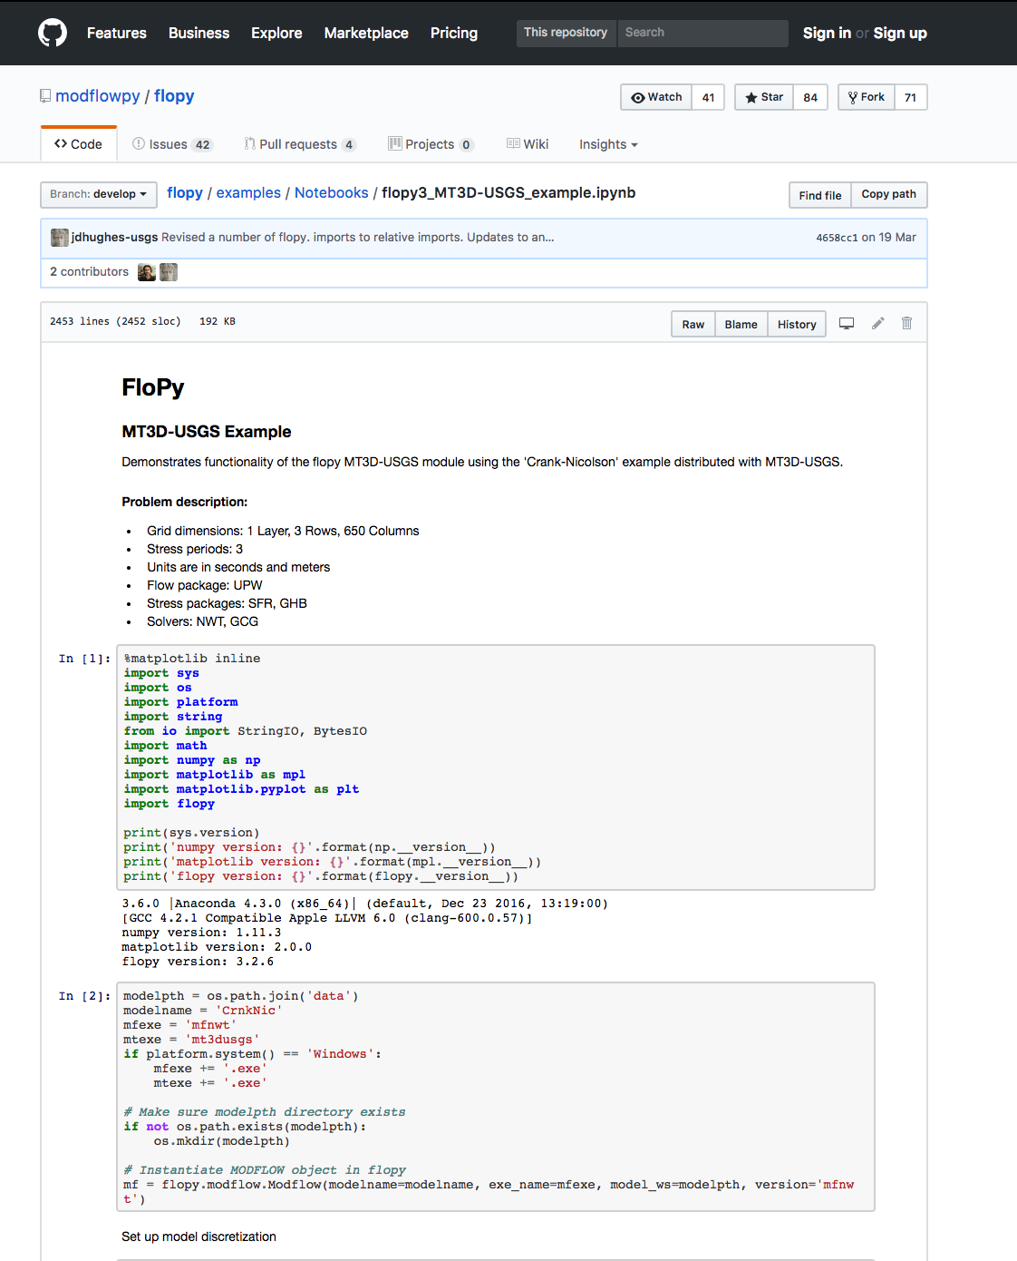
What we are moving to => FloPy3
USGS developed the ‘engines’ over many years; MODFLOW-2005, MODPATH etc…
USGS have released a Python module called ‘FloPy3’ which writes the input files, accesses and runs these engines (written in Fortran or C) and reads the output
Open source and in development – Last update was 7 days ago!
You are the guinea pig’s! Do not fear!
Still working out details for practicals weeks 8, 10, 11
Practical 10 – 11 assessed
A lot of this revolves around editing existing existing codes, room for allowing you explore software and then there will be questions testing fundamental hydrological knowledge.
Extra-demonstrators
You will be able to put ‘Python and GitHub experience’ on your CV
Huge for employers!

Slide 6
What is Matlab?
A high-level language (R2017b) and IDE (integrated development environment)
Developed in 1984
Proprietary (i.e. copyrighted) software – need to pay (£100?) yearly for a license
Used widely. Particularly heavily in academia and also engineering (Simulink)
Reasonably large and active user support community

Slide 7
What is Python?
Just the language => 2.7 + 3.5 most common
Free! – Open source
Developed in 1991
Massive user community – Quickly is becoming THE language to learn.
Superflexible - can be used to
Develop Websites; Django – Whole of Reddit is built with Python!
Machine learning; SciKit learn, Google deep mind etc.
Scientific probably overtaken Matlab at this point; libraries such as BioPython, AstroPython
Unix philosophy – lots of options..
IDE’s -> Spyder, rodeo, PyCharm (paid for)
Also choose your prompt – IPython, bPython…not so interesting
Use your favourite text editor – I use VI
Also the Jupyter Notebook ‘experience’ – Annotated Scripting - This is how you will be handing in your reports.

Slide 8
Structure
Today =>
Introduction
Installing Python + Jupyter (anaconda) & FloPy for PC & Mac
BASH/DOS commands
GitHub – Getting everyone into the classroom
Python – How its different to Matlab
FloPy – Learning on the job! Starting modelling ‘the lake’
HOMEWORK - Submit the lake practical to the GitHub Repo
NO PRESSURE TODAY! Not assessed but essential foundation for future practicals.

Slide 9
BASH (Mac) & DOS (Windows)
These commands are how you interact with a computer by typing
Really useful for repetitive tasks and essential for some tasks
BASH – Next slide
DOS - https://community.sophos.com/kb/en-us/13195

Slide 10
BASH
ls: Show directory contents, lists names of files.
mkdir: Creates a directory of the specified name.
mkdir foo creates a directory called "foo".
cat: Display contents of a file.
cd: Change directory. Change to certain directory name if provided.
cd foo takes you to the directory foo.
Changes to home directory if no directory specified.
cd ../ up one directory ../../ up 2 directories
pwd: Displays the name of the working directory.
less: View contents of specified file, page by page.
head/tail: Displays the first/ last 10 lines of a file.
rm: Removes a specified file. This action is permanent. There is no recycle bin.
NEVER EVER DO rm –rf * if you don’t know what you are doing.
rmdir: Removes a directory.
history: Display a listing of the last commands you've run.
cp: Copy specified file to a new named file. Use -r flag to copy a directory.
mv: Rename a specified file or directory.
find: search files and directories. Can use with wildcards (* ? [ ]).
quota: Print the amount of space available and used on all shares for the current user.
scp: Secure/ SSH copy.
Loads more

Slide 11
UoB Hydro GitHub
‘UoB Hydro’ GitHub classroom will contain all of the instructions for this class and be the location where you can upload your finished assignments (dual upload to Blackboard)
How I created a ‘repo’ within this setting
Used the following instructions => https://help.github.com/articles/adding-an-existing-project-to-github-using-the-command-line/
Only change to windows seems to be opening GitBash instead of terminal
More Learning at home! Watch https://www.youtube.com/watch?v=SWYqp7iY_Tc

Slide 12
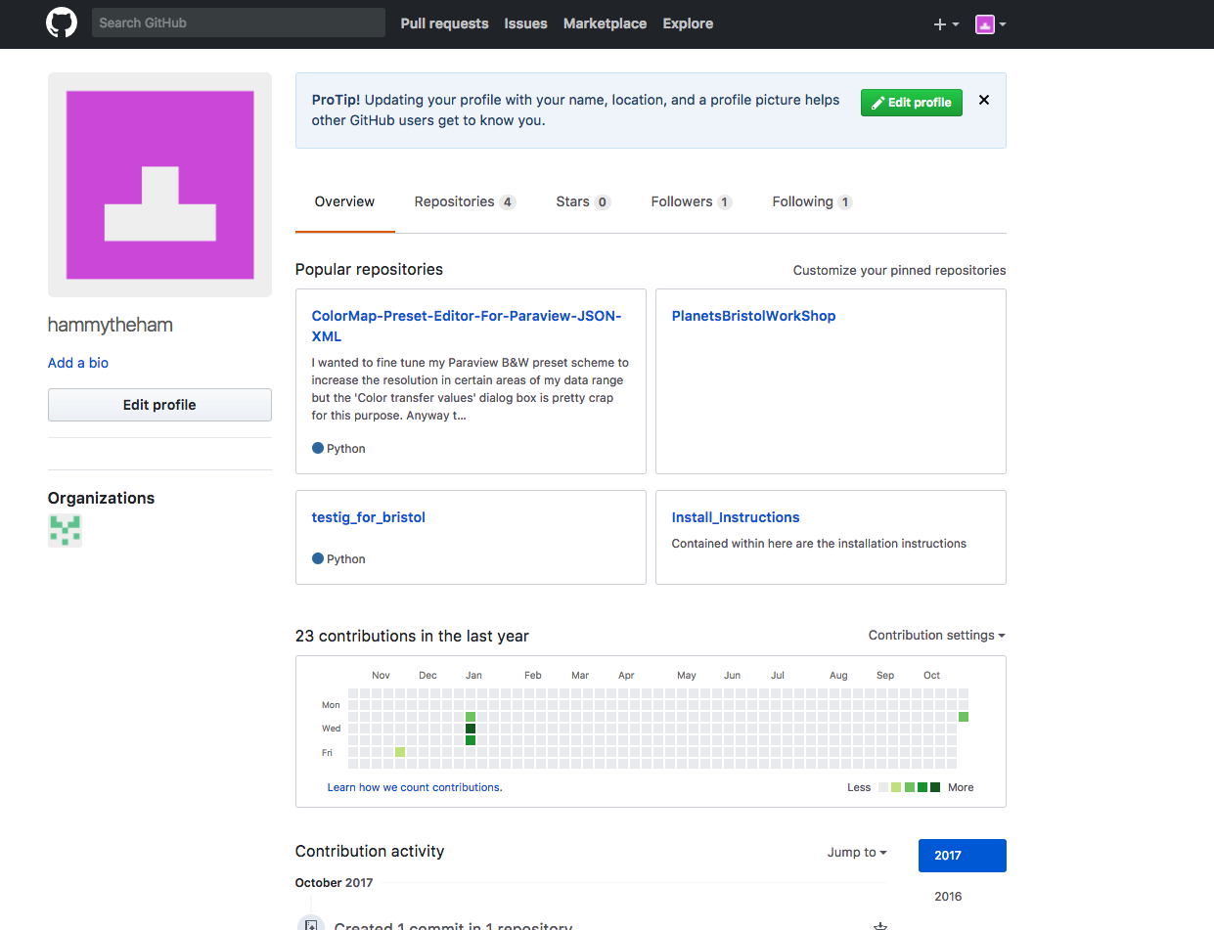
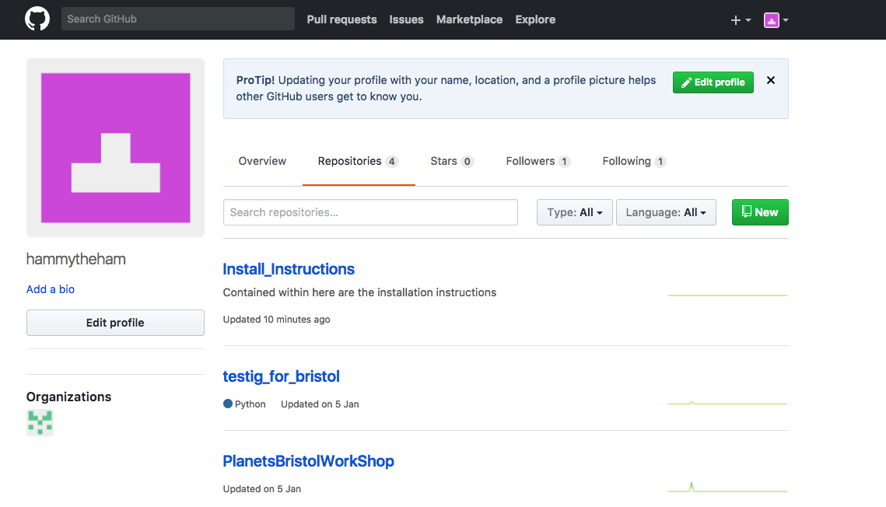
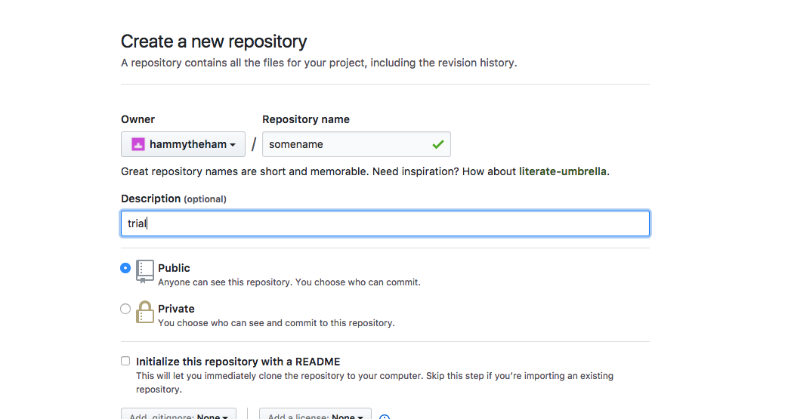
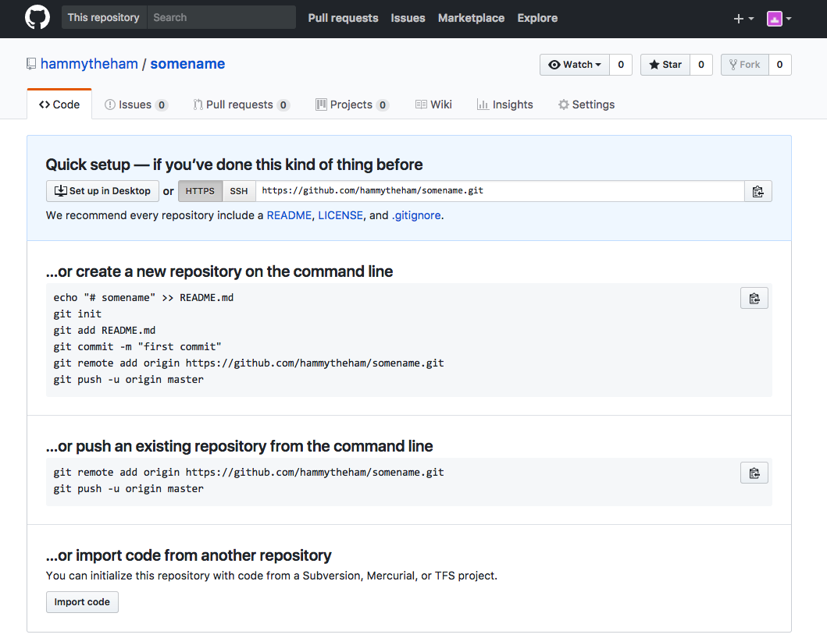

Slide 13
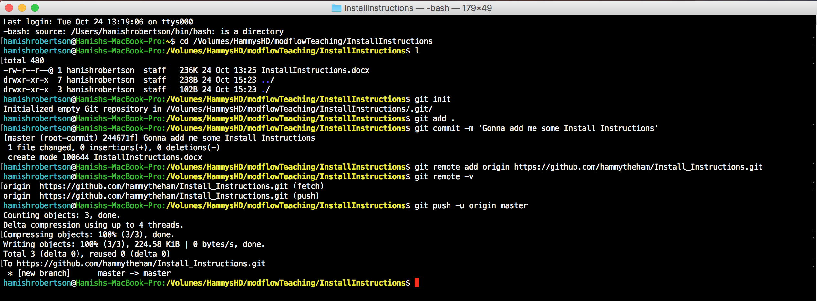
s
From Online github repo

Slide 14
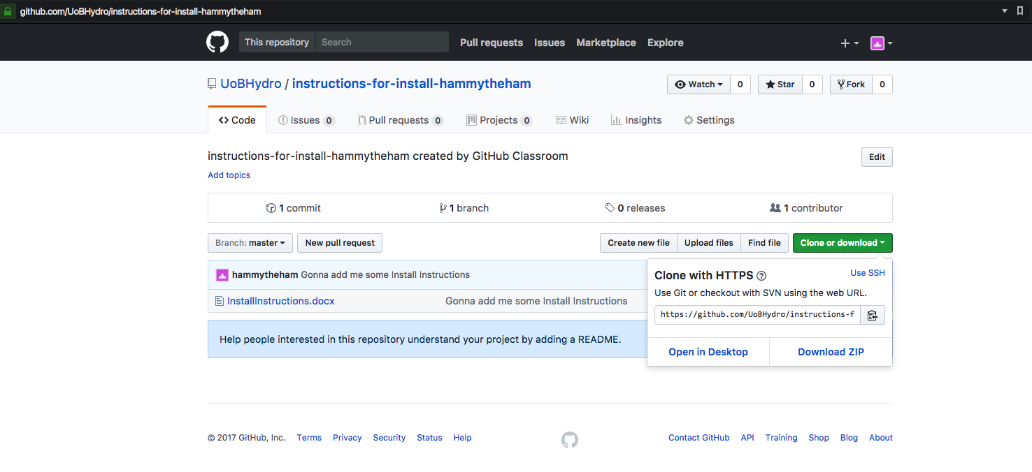
UoB Hydro Practice assignment
Sign into your GitHub profile
Everyone go to https://classroom.github.com/a/9TXEAt-r
Choose the number (1-30) that I’ve given you
You now have access to the first repository
github.com/UoBHydro/Instructions-for-install-username
Click Clone or Download
Hit the copy button
git clone https://github.com/repoaddress

Slide 15
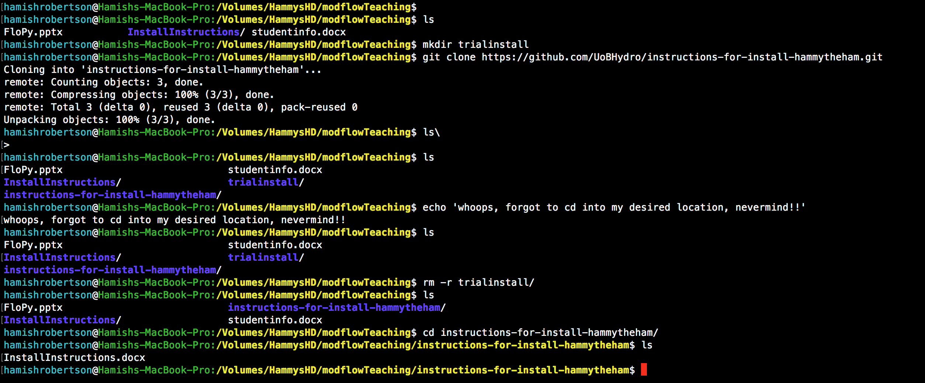

Slide 16
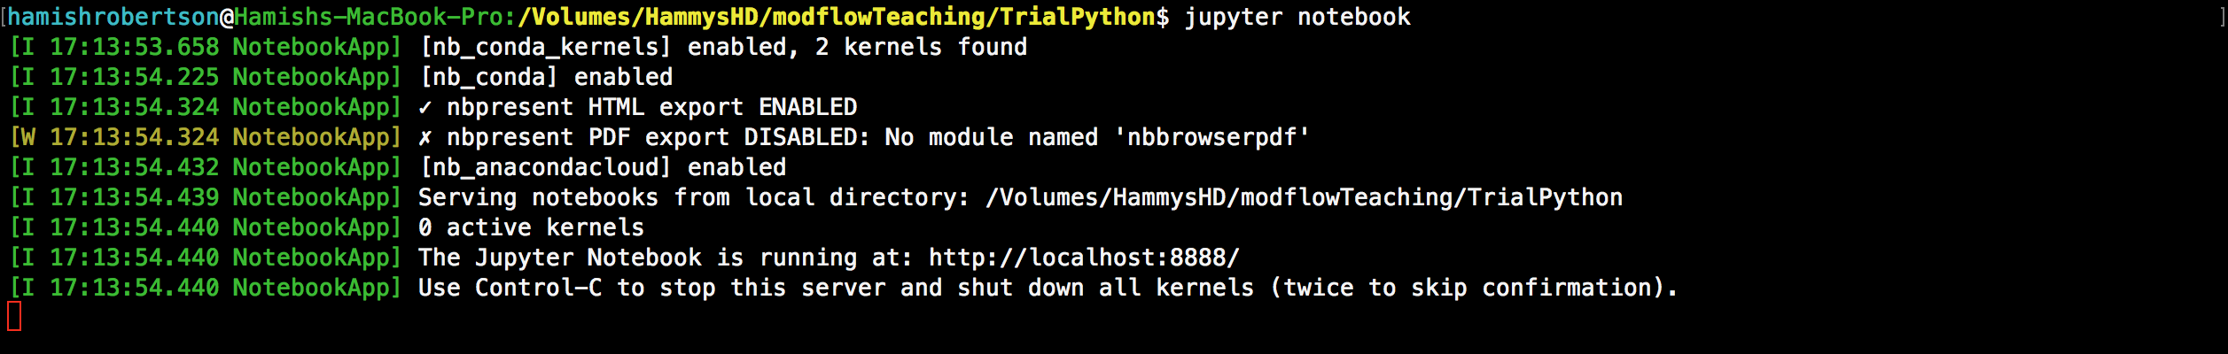
Lets get going with Python…
Make a directory mkdir TrialPython
cd TrialPython
jupyter notebook
What happened?

Slide 17
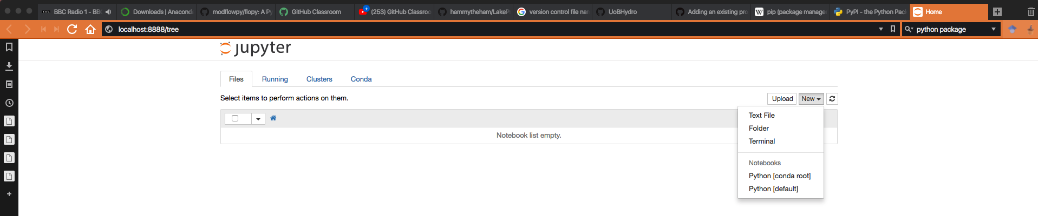
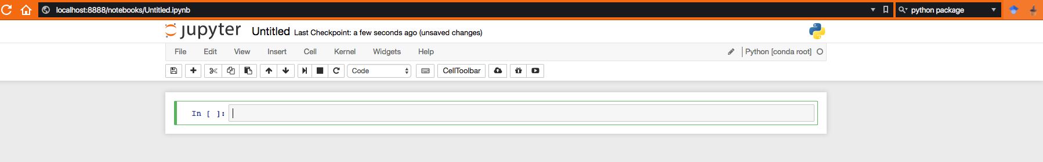
In your web browser…
Choose Python [conda route]
Localhost:8888 is basically code for saying your personal computer
Now follow me…

Slide 18
Click untitled -> rename to your liking
Save file
Make cell blue by clicking the in area bb to add cells
Dd to delete cells
M to change to markup
# or 3 to change to title or small title mode
Up/down arrows should allow you to switch between cells above and bellow.
Lets enter some commands

Slide 19
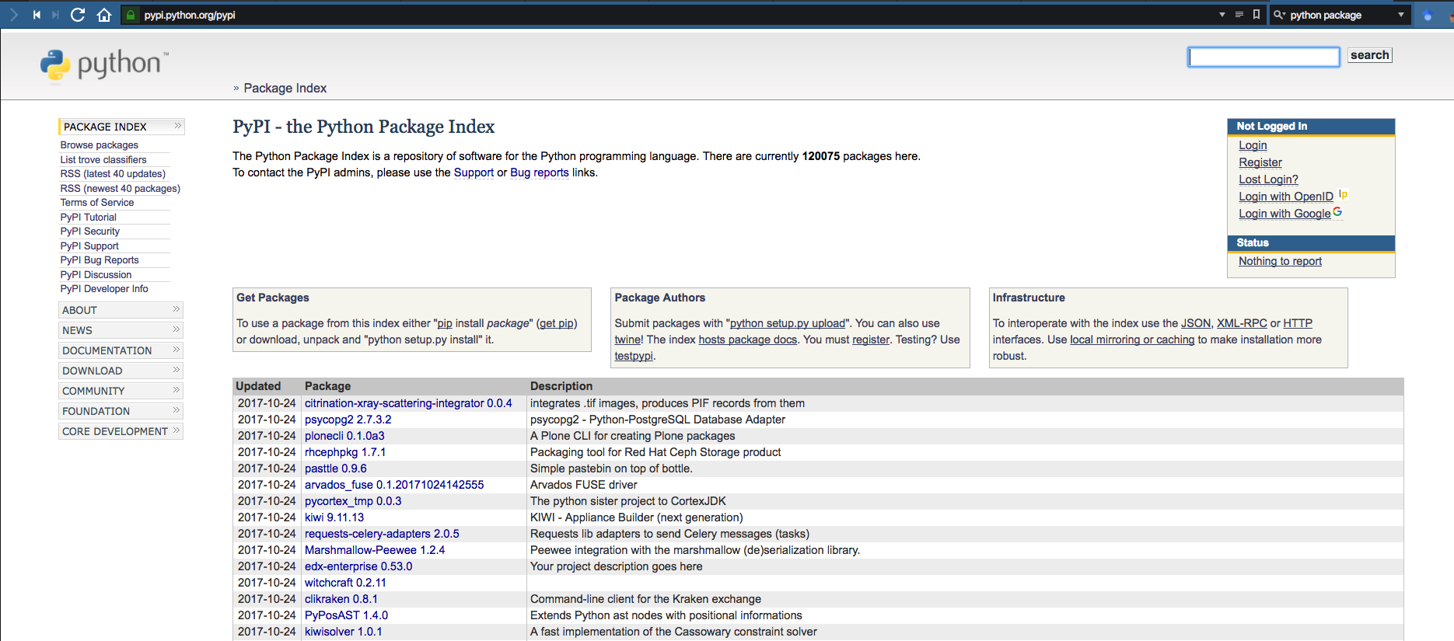
Lets get going…
Anaconda comes with the most commonly used packages e.g. numpy
A package is basically software. Contains functions to which you feed arguments in a pythonic way.
Firstly we need to add the FloPy python package. So cd into your home directory (or anywhere, doesn’t matter)
pip(3.5) install flopy
At a later date
pip install flopy –upgrade
Pip is the python package manager. Allows you update and install python packages through the command

Slide 20
Confined aquifer
https://classroom.github.com/a/YlhRyDKP
Aim is to have everyone up and running today
Start is a 1x10x10 grid
Heads at 10m and 0m
The Modflow engine then calculates what happens between these cells
We then plot the result
10
0
10
1
0
10
0

Slide 21
Ah ze problem!
Python scripts are calling out for the MODFLOW engine. But it can’t find the engine
Need to download the engine from the internet
Go to https://github.com/modflowpy/pymake
pip install https://github.com/modflowpy/pymake/zipball/master
Clone the folder into your Modflow practical
cd examples
python make_mf2005.py
Place that executable somewhere locally
Note do not put the engine on an external hard disk drive. Python scripts may be run from an external
Change the following in the python script;
mf = flopy.modflow.Modflow(modelname, exe_name=’new/location’)
This should now work
WINDOWS PEOPLE I’m not wholey clear atm. Lets have a go!!

Slide 22
Well done!! That was super difficult!!
Don’t stop here…
Try and get used to Python
Read around FloPy
Textbooks on order/in the library which deal directly with FloPy and hydromodelling

